Slide 1
PIZZA SALES
File created on: 11/12/2023 6:09:25 PM

Slide 2
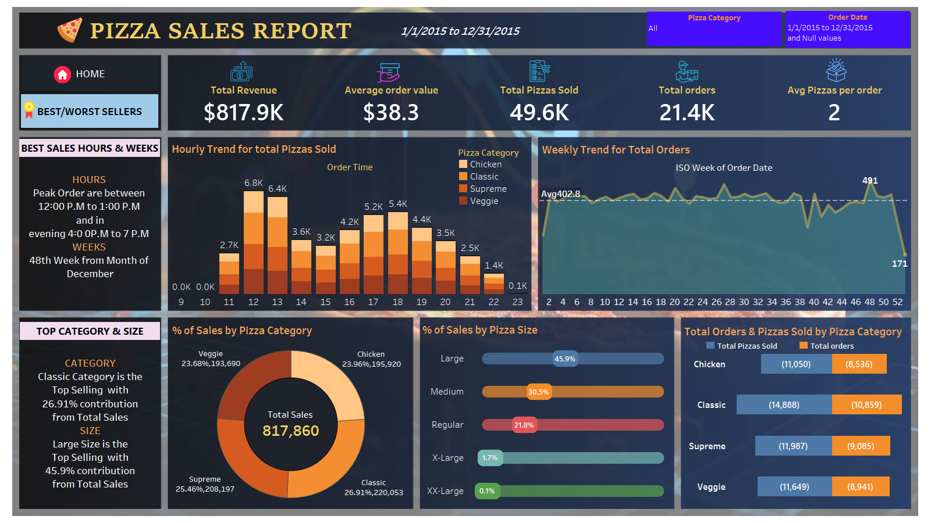

Slide 3
